Slide 1
Digital Bill Of Rights
By: Allison R.,
Rylie D. & Katelyn C.

Slide 2
Freedom
People have the right to say and post what they want on the internet and go on the websites they want.
http://pixabay.com/en/flag-united-states-freedom-july-4th-11702/

Slide 3
Openness
People have the right to go on the websites they want to and not be blocked from them.
http://pixabay.com/en/monitor-pixabay-website-93962/

Slide 4
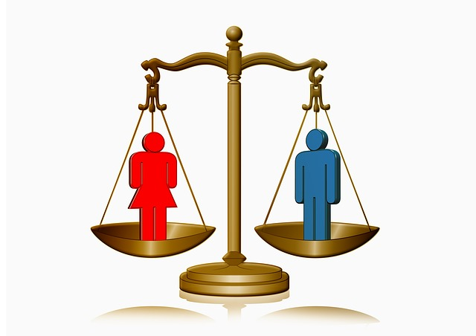
Equality
People are treated equally on the internet- no one should be made fun of or treated differently.
http://pixabay.com/en/man-woman-silhouettes-horizontal-101001/

Slide 5
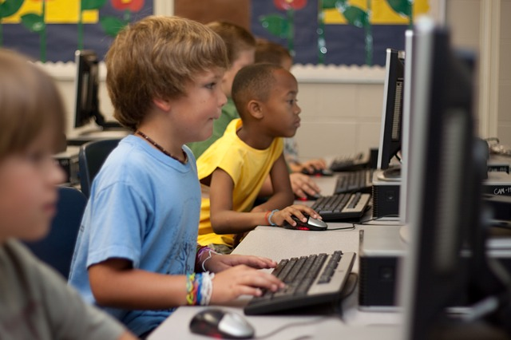
Participation
People have the right to choose whether they want to join a group activity or not when on a website or using the internet.
http://pixabay.com/en/students-computer-young-boy-99506/

Slide 6
Creativity
People have the right to post, say, and create websites, but will be held accountable for what they put.
They have the right to copyright their work, and should not claim other people’s work as their own.
http://pixabay.com/en/reply-all-e-mail-email-letter-post-97621/
http://pixabay.com/en/comments-posts-speak-talk-97860/

Slide 7
Sharing
People have the right to feely share their ideas, posts, and pictures on the internet.
If you did a group project, you should share the credit with everyone who contributed to the project.
http://pixabay.com/en/photos/?q=blog&orientation=&image_type=

Slide 8
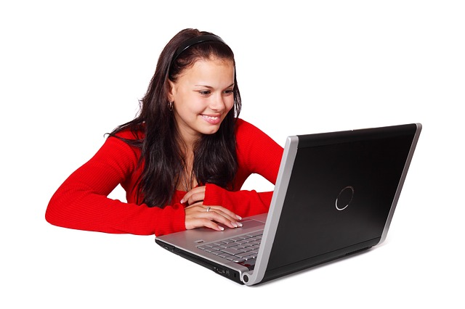
Accessibility
People have the right to access the internet, no matter who or where they are.
http://pixabay.com/en/beautiful-business-computer-female-15728/

Slide 9
Association
People have the right to freely talk to whomever they want on the internet.
http://pixabay.com/en/shaking-hands-hand-hand-oak-96298/

Slide 10
Privacy
People have the right to privacy on the internet.
http://pixabay.com/en/town-sign-shield-private-privacy-83730/

Slide 11
Property
People have the right to benefit from what they create or put on the internet.
http://pixabay.com/en/park-sign-information-parking-44314/

Slide 12
THE END

